Slide 1


Advanced Business Analytics Seminar Winter Semester 23/24
Analysis of Continuous Manufacturing Sensor data with REHAU

Slide 2








TEAM
Our Advisor
Markus Schamberger, M.Sc.
▪ markus.schamberger@fau.de
▪ https://wi2.fau.de/person/sc/
▪ Room: 4.437
Our Team
Souhardya Chattopadhyay
M.Sc. Data Science Student
FAU Erlangen-Nürnberg
souhardya.chattopadhyay@fau.de
Uddipan Basu Bir
M.Sc. Data Science Student
FAU Erlangen-Nürnberg
uddipan.bir.basu@fau.de
Shouvik Chattopadhyay
M.Sc. Data Science Student
FAU Erlangen-Nürnberg
shouvik.chattopadhyay@fau.de
Zain Asif
M.Sc. Data Science Student
FAU Erlangen-Nürnberg
zain.asif@fau.de
Advanced Business Analytics Seminar | WS 23/24 | 07.03.2024

Slide 3

TOPIC
Analysis of continuous manufacturing polymer extrusion sensor data with REHAU
The shift towards Industry 4.0 entails a gradual rise in the intricacy of system operations and the management of production processes. Concurrently, emerging technologies present opportunities for enhancing services and cutting costs. With machines becoming more digitized, substantial amounts of data are now being collected. Utilizing data-driven methods becomes a viable solution to address the growing complexity and unlock potential benefits.
Objectives
▪ Identify polymer extrusion process dependencies and causalities.
▪ How do sensor parameters influence each other?
▪ Building data-driven process-model from data
▪ Model to simulate „what-if“ - scenarios
Figure only for representation
Advanced Business Analytics Seminar | WS 23/24 | 07.03.2024

Slide 4
OVERVIEW
Data Overview & Initial Findings
Hopper Section
Dependencies
Model Building 1 & its What if Scenarios
Model Building 2
Main Extruder
Model Building 1 & What if Scenarios
Dependencies
Model Building 2
ADF Testing
Granger Causality Test
Future Endeavours
Advanced Business Analytics Seminar | WS 23/24 | 07.03.2024

Slide 5
DATA OVERVIEW
RAW DATA
6.8 M rows X 93 columns
HOPPER SECTION
MAIN EXTRUDER SECTION
Total 5 Hoppers. For each hopper we have:
Temperature
Power
Rotation Speed
Weight
Throughput
Main sensor parameters:
Funnel Active
Temperature
Pressure
Screw Load
Screw Rotation speed
Vacuum
Total 16 zones. For each zone, we have:
Control Point
Temperature
Advanced Business Analytics Seminar | WS 23/24 | 07.03.2024

Slide 6
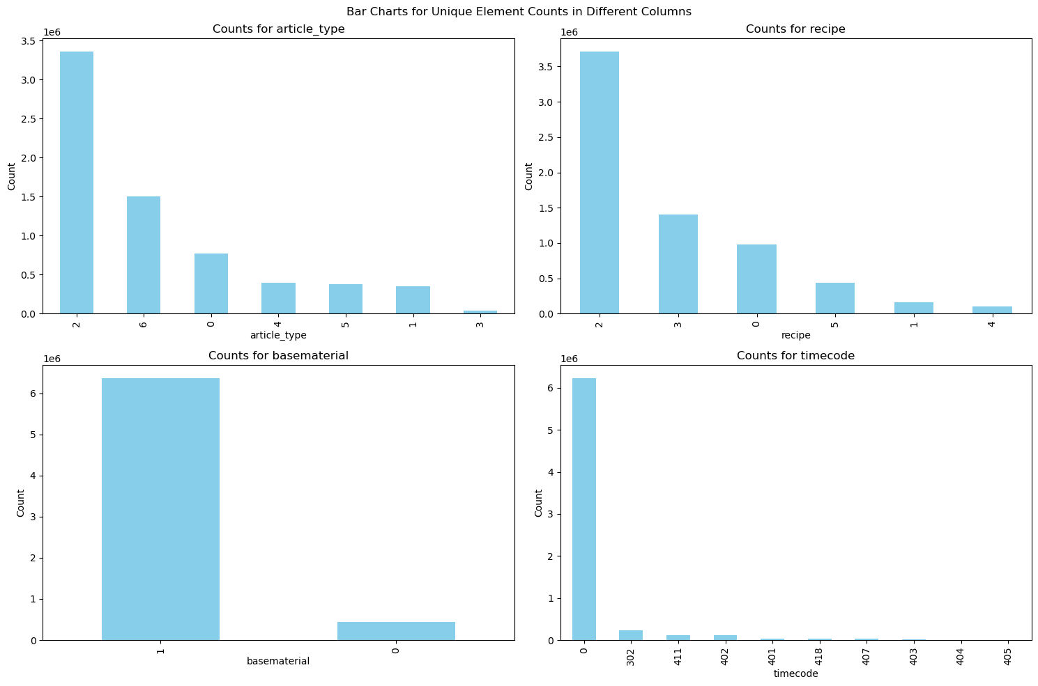
INITIAL FINDINGS
Timecode 0 represents production time in line with specifications and others represent machine/article failure time.
50% of the observations represent Article type 2.
Advanced Business Analytics Seminar | WS 23/24 | 07.03.2024

Slide 7
OVERVIEW
Data Overview & Initial Findings
Hopper Section
Dependencies
Model Building 1 & its What if Scenarios
Model Building 2
Main Extruder
Model Building 1 & What if Scenarios
Dependencies
Model Building 2
ADF Testing
Granger Causality Test
Future Endeavours
Advanced Business Analytics Seminar | WS 23/24 | 07.03.2024

Slide 8
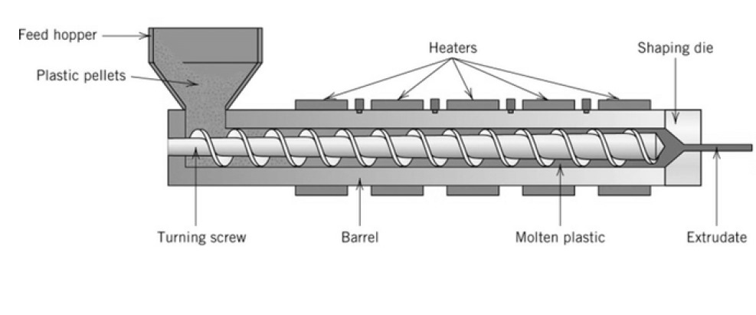
HOPPER SECTION
HOPPER
Advanced Business Analytics Seminar | WS 23/24 | 07.03.2024

Slide 9
HOPPER : DEPENDENCIES
Strong Correlation | Weak Correlation | No Correlation
Hopper 1-4 | Temperature | Power / Throughput / Rotation speed | Weight
Temperature
Power / Throughput / Rotation speed
Weight
Hoppers 1-4 exhibit consistent correlation patterns among various sensor parameters.
The high degree of similarity between Power, Throughput & Rotation speed suggests a cohesive behavior in the relationships between these sensors.
Hopper 5 | Temperature | Power / Throughput / Rotation speed | Weight
Temperature
Power / Throughput / Rotation speed
Weight
Hopper 5 displays a slight deviation in correlation patterns compared to Hoppers 1-4.
This distinct behavior in Hopper 5 may indicate unique operational characteristics or specific influences on the correlation between its sensor parameters.
Advanced Business Analytics Seminar | WS 23/24 | 07.03.2024

Slide 10
HOPPER : MODEL BUILDING 1
Objective: Optimizing Hopper Parameter Coefficients for Precise Throughput Prediction
Goal: Attain optimal coefficients for hopper parameters to predict throughput, closely aligning with predefined throughput standards.
Striving for a model that ensures accurate throughput predictions based on specified hopper features.
Features and Target
Parameters under consideration: Temperature, Power, Rotation Speed and Weight.
Target variable for prediction: Throughput - the key performance indicator.
Model and Approach: Lasso Regression, but why Lasso?
Lasso regression performs variable selection by imposing a penalty on the absolute size of the regression coefficients. This means that it tends to shrink the coefficients of less important variables towards zero, effectively selecting the most relevant variables. In the context of the hopper section, where various factors (e.g., temperature, pressure, screw speed) might affect the extrusion process, Lasso can help identify the most influential variables among a large set of potential predictors.
Regularization: Lasso regression incorporates a regularization parameter that helps prevent overfitting by penalizing large coefficient values.
Advanced Business Analytics Seminar | WS 23/24 | 07.03.2024

Slide 11
HOPPER : MODEL BUILDING 1
For simplicity of this presentation we have chosen Article Type 2 in this model since it covered 50% of the overall data.
Coefficients:
Feature 1: -0.0
Feature 2: -0.09
Feature 3: 0.33
Feature 4: 0.26
Feature 5: 0.09
Feature 6: 0.07
Feature 7: 0.12
Feature 8: -0.14
Feature 9: 0.0
Feature 10: 0.0
Feature 11: 0.04
Feature 12: -0.0
Feature 13: -0.0
Feature 14: 0.0
Feature 15: 0.13
Feature 16: -0.0
Feature 17: 0.38
Feature 18: 0.50
Feature 19: 0.08
Feature 20: 0.0004
What does this coefficient signify?
Coefficient in a Machine Learning modelling represents the weight or magnitude of influence that a particular feature has on the predicted outcome. In Mathematical terms for a 2 feature model,
y = m1x1 + m2x2 + b, where:
y = predicted outcome x1, x2 = input / feature values
m1, m2 = coefficients associated with inputs
Important Features and their Coefficients:
Hopper 1 Power: -0.09
Hopper 1 Rotation Speed: 0.33
Hopper 1 Weight: 0.26
Hopper 2 Temperature: 0.09
Hopper 2 Power: 0.07
Hopper 2 Rotation Speed: 0.12
Hopper 2 Weight: -0.14
Hopper 3 Rotation Speed: 0.04
Hopper 4 Rotation Speed: 0.13
Hopper 5 Temperature: 0.38
Hopper 5 Power: 0.50
Hopper 5 Rotation Speed: 0.08
Hopper 5 Weight: 0.0004
Advanced Business Analytics Seminar | WS 23/24 | 07.03.2024

Slide 12
HOPPER : WHAT IF ANALYSIS FOR MODEL 1
What if we increase the Temperature of Hopper 5 by 5%
Feature | Value
Hopper 1 Temp | 24.06
Hopper 1 Power | 70.9
Hopper 1 Rotation Speed | 34.24
Hopper 1 Weight | 6.52
Hopper 2 Temp | 26.32
Hopper 2 Power | 0
Hopper 2 Rotation Speed | 0
Hopper 2 Weight | 3.11
Hopper 3 Temp | 23.29
Hopper 3 Power | 0
Hopper 3 Rotation Speed | 0
Hopper 3 Weight | 3.86
Hopper 4 Temp | 22.31
Hopper 4 Power | 0
Hopper 4 Rotation Speed | 0
Hopper 4 Weight | 4.15
Hopper 5 Temp | 304.55
Hopper 5 Power | 0
Hopper 5 Rotation Speed | 0
Hopper 5 Weight | 8.09
Result: Observing a 4.66% increase in the model's throughput prediction with the implemented Hopper 5 Temperature adjustment.
Predicted output before increase : 124.39 kg/h
Predicted output after increase : 130.18 kg/h
Percentage Change: 4.66 %
Advanced Business Analytics Seminar | WS 23/24 | 07.03.2024

Slide 13
HOPPER : WHAT IF ANALYSIS FOR MODEL 1
What if we increase the Power of Hopper 1 by 20%
Feature | Value
Hopper 1 Temp | 24.06
Hopper 1 Power | 70.9
Hopper 1 Rotation Speed | 34.24
Hopper 1 Weight | 6.52
Hopper 2 Temp | 26.32
Hopper 2 Power | 0
Hopper 2 Rotation Speed | 0
Hopper 2 Weight | 3.11
Hopper 3 Temp | 23.29
Hopper 3 Power | 0
Hopper 3 Rotation Speed | 0
Hopper 3 Weight | 3.86
Hopper 4 Temp | 22.31
Hopper 4 Power | 0
Hopper 4 Rotation Speed | 0
Hopper 4 Weight | 4.15
Hopper 5 Temp | 304.55
Hopper 5 Power | 0
Hopper 5 Rotation Speed | 0
Hopper 5 Weight | 8.09
Result: Observing a 1.03% decrease in the model's throughput prediction with the implemented Hopper 1 Power adjustment.
Predicted output before increase: 124.38 kg/h
Predicted output after increase: 123.10 kg/h
Percentage change: -1.03%
Advanced Business Analytics Seminar | WS 23/24 | 07.03.2024

Slide 14
HOPPER : WHAT IF ANALYSIS FOR MODEL 1
What if we decrease the Temperature of Hopper 3 by 5%
Feature | Value
Hopper 1 Temp | 24.06
Hopper 1 Power | 70.9
Hopper 1 Rotation Speed | 34.24
Hopper 1 Weight | 6.52
Hopper 2 Temp | 26.32
Hopper 2 Power | 0
Hopper 2 Rotation Speed | 0
Hopper 2 Weight | 3.11
Hopper 3 Temp | 23.29
Hopper 3 Power | 0
Hopper 3 Rotation Speed | 0
Hopper 3 Weight | 3.86
Hopper 4 Temp | 22.31
Hopper 4 Power | 0
Hopper 4 Rotation Speed | 0
Hopper 4 Weight | 4.15
Hopper 5 Temp | 304.55
Hopper 5 Power | 0
Hopper 5 Rotation Speed | 0
Hopper 5 Weight | 8.09
Result: Observing a no significant change in the model's throughput prediction with the implemented Hopper 3 Temperature adjustment.
Predicted output before decrease: 124.38 kg/h
Predicted output after decrease: 124.38 kg/h
Percentage change: 0%
Advanced Business Analytics Seminar | WS 23/24 | 07.03.2024

Slide 15
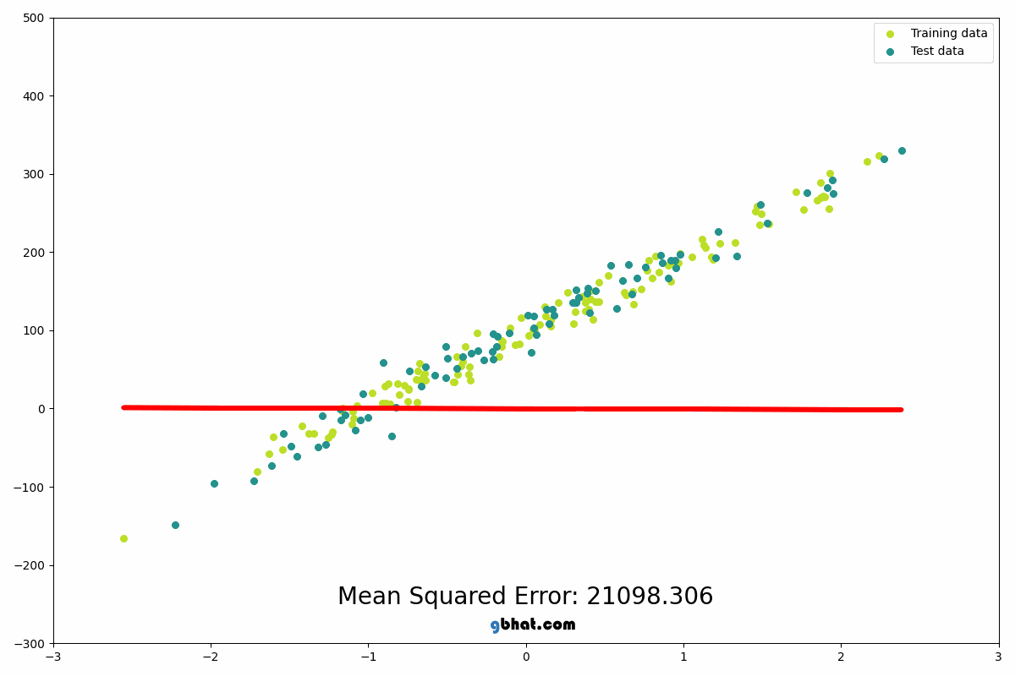
HOPPER : MODEL BUILDING 2
Objective: Optimizing Hopper Parameter Coefficients for Precise Throughput Prediction
Goal: Observe mathematical relation between throughput of each individual hopper.
Striving for a model that ensures accurate throughput predictions based on specified hopper throughputs.
Features and Target
Parameters under consideration: Throughput act of each hopper.
Target variable for prediction: Throughput set.
Model and Approach: Linear Regression
Linear regression is a statistical method used to model the
relationship between a dependent variable and one or more
independent variables by fitting a linear equation to observed
data, aiming to predict the dependent variable's value based
on the independent variable(s).
Figure only for representation
Advanced Business Analytics Seminar | WS 23/24 | 07.03.2024

Slide 16
HOPPER : MODEL BUILDING 2
Contribution of each Hopper Throughput towards the Final Throughput for each Article type
Article Type 1
Features Coefficients
Hopper 4 Throughput:: 0.07
Article type 2
Feature Coefficients
Hopper 1 Throughput:-0.03
Hopper 2 Throughput: 0.05
Hopper 3 Throughput: 0.01
Hopper 4 Throughput: 0.23
Hopper 5 Throughput: 0.01
Article Type 0 has only Hopper 4 contributing to the final Throughput
Article 2 is the only article type which has all the Hoppers from 1 to 5 contributing towards the final throughput.
Advanced Business Analytics Seminar | WS 23/24 | 07.03.2024

Slide 17
HOPPER : MODEL BUILDING 2
Contribution of each Hopper Throughput towards the Final Throughput for each Article type
Article type 0
Feature Coefficients
Hopper 1 Throughput: 0.45
Hopper 2 Throughput: 3.23
Hopper 3 Throughput: 3.22
Hopper 5 Throughput: 0.10
Article Type 3
Features Coefficients
Hopper 1 Throughput: 0.05
Hopper 2 Throughput: 1.38
Hopper 3 Throughput:-0.08
Hopper 5 Throughput:-0.02
Article Type 4
Features Coefficients
Hopper 1 Throughput: 0.05
Hopper 2 Throughput: 2.77
Hopper 3 Throughput: 0.01
Hopper 5 Throughput: 0.08
Article Type 5
Features Coefficients
Hopper 1 Throughput: 0.26
Hopper 2 Throughput: 0.00
Hopper 3 Throughput: 0.18
Hopper 5 Throughput: 0.07
Article Type 6
Features Coefficients
Hopper 1 Throughput: 0.60
Hopper 2 Throughput: 1.03
Hopper 3 Throughput: 1.07
Hopper 5 Throughput: 0.03
Each of the article type here does not have the contribution of Hopper 4's Throughput towards the final Throughput.
Advanced Business Analytics Seminar | WS 23/24 | 07.03.2024

Slide 18
OVERVIEW
Data Overview & Initial Findings
Hopper Section
Dependencies
Model Building 1 & its What if Scenarios
Model Building 2
Main Extruder
Model Building 1 & What if Scenarios
Dependencies
Model Building 2
ADF Testing
Granger Causality Test
Future Endeavours
Advanced Business Analytics Seminar | WS 23/24 | 07.03.2024

Slide 19
MAIN EXTRUDER SECTION
MAIN EXTRUDER
Advanced Business Analytics Seminar | WS 23/24 | 07.03.2024

Slide 20
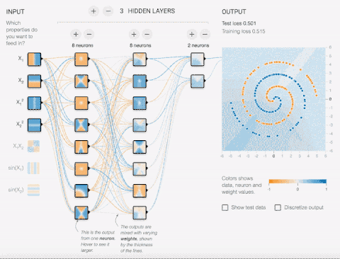
MAIN EXTRUDER : MODEL BUILDING 1
Objective: Optimizing Main extruder parameters Coefficients for Precise Throughput Prediction​
Goal: To understand the mathematical relation between main extruder sensor parameters.
Features and Target
Parameters under consideration : Input Throughput, Funnel Active, Melt Temperature, Screw Load, Screw Rotation Speed, Vacuum.
Target variable for prediction : Melt Temperature & Pressure.
Model and Approach: Neural Network, but why?
Neural networks are adept at capturing and modeling the intricate nonlinear relationships inherent in polymer extrusion processes.
Main extruder portion data is highly complex and non-linear in nature so that regular linear/ridge/lasso is not a good fit for this scenario. So in order to increase the model accuracy neural net is a good choice.
Figure only for representation
Advanced Business Analytics Seminar | WS 23/24 | 07.03.2024

Slide 21
MAIN EXTRUDER : MODEL BUILDING 1
Neural Network Architecture
INPUT
HIDDEN LAYER 1
HIDDEN LAYER 2
HIDDEN LAYER 3
OUTPUT
128 Neurons
32 Neurons
64 Neurons
We have passed the main extruder features to the input layer and then output is passed through the following consecutive hidden layers and finally output layer is responsible for the desired prediction.
As we proceed through the hidden layers our model learns more abstract features gradually leading to a trustworthy accurate output.
Advanced Business Analytics Seminar | WS 23/24 | 07.03.2024

Slide 22
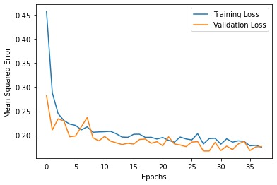
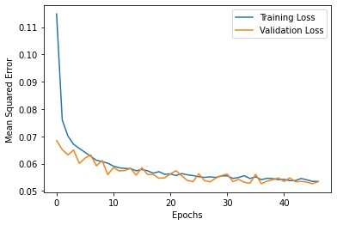
MAIN EXTRUDER : MODEL BUILDING 1
Neural Network Training Visualization :
Loss curve for temperature as target column
Loss curve for pressure as target column
Advanced Business Analytics Seminar | WS 23/24 | 07.03.2024

Slide 23
MAIN EXTRUDER : WHAT IF ANALYSIS FOR MODEL 1
What if we increase the Screw Rotation Speed by 5%, how will the Melt Pressure be affected?
Feature | Standardized Value
Total Throughput | 0.13
Funnel Active | 0
Melt Temperature | 0.65
Screw Load | 2.37
Screw Rotation Speed | 0.24
Vacuum | -0.12
Result: Observing a 1.37% decrease in the model's Melt Pressure with the implemented Screw Rotation Speed adjustment.
Predicted output before increase (Standardized): 0.51 bar
Predicted output after increase (Standardized): 0.50 bar
Percentage Change: -1.37 %
Advanced Business Analytics Seminar | WS 23/24 | 07.03.2024

Slide 24
MAIN EXTRUDER : WHAT IF ANALYSIS FOR MODEL 1
What if we increase the Screw Rotation Speed by 5%, how will the Melt Temperature be affected?
Feature | Standardized Value
Total Throughput | 0.13
Funnel Active | 0
Melt Pressure | -0.03
Screw Load | 2.37
Screw Rotation Speed | 0.24
Vacuum | -0.12
Result: Observing a 0.11% increase in the model's Melt Temperature with the implemented Screw Rotation Speed adjustment.
Predicted output before increase (Standardized): 1.256
Predicted output after increase (Standardized): 1.257
Percentage Change: 0.11 %
Advanced Business Analytics Seminar | WS 23/24 | 07.03.2024

Slide 25
MAIN EXTRUDER ZONES 1-16 : DEPENDENCIES
Strong Correlation | Moderate Correlation | No Correlation
Zones 1-16 | Temp Zones 1-12 & 15-16 | Temp Zone 13 | Temp Zone 14
Temp Zones 1-12 & 15-16
Temp Zone 13
Temp Zone 14
Zones 1-12 & 15-16 exhibit consistent strong correlation patterns among each other.
Zone 13 has almost no correlation with other zones.
Zone 14 has a moderate correlation with other zones.
Advanced Business Analytics Seminar | WS 23/24 | 07.03.2024

Slide 26
MAIN EXTRUDER : MODEL BUILDING 2
Objective: Optimizing Zonal Parameter Coefficients for main extruder parameters prediction
Goal: To understand the mathematical relation between main extruder and heating power & temperature zones 1-16.
Striving for a model that ensures accurate main extruder parameters prediction based on specific zonal features.
Features and Target
Parameters under consideration : Temperature & Control point.
Target variable for prediction : Melt Temperature, Melt Pressure, Screw Load, Screw Rotation Speed, Vacuum.
Model and Approach: Lasso Regression, but why Lasso?
Lasso regression performs variable selection by imposing a penalty on the absolute size of the regression coefficients. This means that it tends to shrink the coefficients of less important variables towards zero, effectively selecting the most relevant variables. In the context of the hopper section, where various factors (e.g., temperature, pressure, screw speed) might affect the extrusion process, Lasso can help identify the most influential variables among a large set of potential predictors.
Regularization: Lasso regression incorporates a regularization parameter that helps prevent overfitting by penalizing large coefficient values.
Advanced Business Analytics Seminar | WS 23/24 | 07.03.2024

Slide 27
MAIN EXTRUDER : MODEL BUILDING 2
Contribution of each Zones to Main extruder parameters
Screw Load
Feature Coefficients
Zone 5 Temperature : 2.01
Zone 7 Temperature : -0.56
Zone 9 Temperature : -0.52
Zone 2 Ctrl Point : -0.02
Zone 3 Ctrl Point : -0.23
Zone 4 Ctrl Point : -0.19
Zone 5 Ctrl Point : -0.81
Zone 8 Ctrl Point : 0.07
Zone 12 Ctrl Point: 0.006
Pressure
Feature Coefficients
Zone 1 Temperature : 0.61
Zone 3 Temperature : 0.02
Zone 4 Temperature : 0.21
Zone 7 Temperature : 0.006
Zone 10 Temperature : 0.13
Zone 3 Ctrl Point : 0.05
Zone 4 Ctrl Point : 0.02
Zone 5 Ctrl Point : -0.95
Zone 8 Ctrl Point : 0.04
Zone 12 Ctrl Point : 0.005
Temp Zone 5 and Control Zone 5 contributes the most towards Screw Load positively and negatively based on the coefficient values.
Temp Zone 1 and Control Zone 5 contributes the most towards Pressure positively and negatively based on the coefficient values.
Advanced Business Analytics Seminar | WS 23/24 | 07.03.2024

Slide 28
MAIN EXTRUDER : MODEL BUILDING 2
Contribution of each Zones to Main extruder parameters
Temperature
Feature Coefficients
Zone 1 Temperature : 0.81
Zone 2 Temperature : 0.004
Zone 5 Temperature : 0.17
Zone 1 Ctrl Point : 0.05
Zone 4 Ctrl Point : -0.02
Zone 5 Ctrl Point : -0.85
Zone 8 Ctrl Point : 0.009
Zone 10 Ctrl Point : 0.03
Zone 11 Ctrl Point : 0.004
Zone 12 Ctrl Point : 0.046
Screw Rotation speed
Feature Coefficients
Zone 1 Temperature : 0.96
Zone 2 Temperature :0.0009
Zone 4 Temperature :0.0001
Zone 5 Temperature : 0.03
Zone 1 Ctrl Point : 0.05
Zone 4 Ctrl Point :-0.005
Zone 5 Ctrl Point :-0.86
Zone 8 Ctrl Point : 0.01
Zone 10 Ctrl Point: 0.04
Zone 12 Ctrl Point: 0.05
Vacuum
Feature Coefficients
Zone 1 Temperature : 0.59
Zone 4 Temperature : 0.08
Zone 5 Temperature : 0.17
Zone 7 Temperature : 0.05
Zone 14 Temperature:0.06
Zone 1 Ctrl Point : 0.03
Zone 4 Ctrl Point : -0.03
Zone 5 Ctrl Point : -0.85
Zone 10 Ctrl Point: 0.03
Zone 11 Ctrl Point: 0.01
Zone 12 Ctrl Point: 0.02
Temp Zone 1 and Control Zone 5 contributes the most towards Temperature positively and negatively based on the coefficient values.
Temp Zone 1 and Control Zone 5 contributes the most towards Screw Rotation Speed positively and negatively based on the coefficient values.
Temp Zone 1 and Control Zone 5 contributes the most towards Vacuum positively and negatively based on the coefficient values.
Advanced Business Analytics Seminar | WS 23/24 | 07.03.2024

Slide 29
MAIN EXTRUDER : ADF TESTING
Why ADF Testing?
ADF test is a valuable tool for analyzing time series data, providing insights into the underlying properties of the data and guiding the selection of appropriate modeling techniques. Stationary data refers to a time series dataset whose statistical properties such as mean, variance, and autocovariance remain constant over time.
Benefits:
Detection of Structural Changes: Changes in the statistical properties of time series data, such as shifts in mean or variance, can signal structural changes in regulations or consumer preferences.
Causal Inference: ADF testing can be used in conjunction with other econometric techniques to explore causal relationships between variables.
Improved Decision-Making: Stationary time series data provides a stable foundation for analyzing historical trends and making informed decisions.
Advanced Business Analytics Seminar | WS 23/24 | 07.03.2024

Slide 30
MAIN EXTRUDER : ADF TESTING RESULTS
Melt Pressure:
ADF Statistic: -7.55, p-value: 3.22e-11
Conclusion: Reject the null hypothesis, the time series is likely stationary.
Melt Temperature:
ADF Statistic: -8.33, p-value: 3.30e-13
Conclusion: Reject the null hypothesis, the time series is likely stationary.
Screw Load:
ADF Statistic: -7.17, p-value: 2.78e-10
Conclusion: Reject the null hypothesis, the time series is likely stationary.
Vacuum:
ADF Statistic: -12.17, p-value: 1.41e-22
Conclusion: Reject the null hypothesis, the time series is likely stationary.
Screw Rotation Speed:
ADF Statistic: -6.87, p-value: 1.53e-09
Conclusion: Reject the null hypothesis, the time series is likely stationary.
Advanced Business Analytics Seminar | WS 23/24 | 07.03.2024

Slide 31
MAIN EXTRUDER : GRANGER CAUSALITY TEST
Objective
The main purpose of the Granger causality test is to determine whether one time series variable can reliably predict future values of another time series variable. ​
​
​
Approach
We have taken 3 time lags here.
"lag" refers to the number of past observations of a variable that are included in the model to predict the current value of another variable.​
Sensory data that are included in the test are Temperature, Pressure, Screw Load and Screw Rotation speed​
Advanced Business Analytics Seminar | WS 23/24 | 07.03.2024

Slide 32
MAIN EXTRUDER : GRANGER CAUSALITY TEST RESULTS
Melt Pressure
Temperature causes changes in 'Pressure' at all tested lag lengths.
Screw Load causes changes in 'Pressure' at all tested lag lengths.
Screw Rotation speed does not Granger cause changes in 'Pressure' at lag lengths 1 and 2, but it does at lag length 3.
Temperature
Pressure does not Granger cause changes in 'Temperature'.
Both screw load and screw rotation speed do have a Granger causality relationship with Temperature.
Screw Load
Both Temperature and screw rotation speed Granger cause changes in screw load, whereas pressure only shows significant evidence of causing changes in screw load at lag 2 and 3.
Screw Rotation Speed
Pressure Granger cause changes in Screw rotation speed at lag 2 and 3.
Temperature Granger cause changes in Screw rotation speed at all lag lengths.
Screw Load influence changes in Screw rotation speed at lag 2 and 3.
Advanced Business Analytics Seminar | WS 23/24 | 07.03.2024

Slide 33
OVERVIEW
Data Overview & Initial Findings
Hopper Section
Dependencies
Model Building 1 & its What if Scenarios
Model Building 2
Main Extruder
Model Building 1 & What if Scenarios
Dependencies
Model Building 2
ADF Testing
Granger Causality Test
Future Endeavours
Advanced Business Analytics Seminar | WS 23/24 | 07.03.2024

Slide 34
FUTURE ENDEAVORS
Specific energy consumption (SEC) of a hopper = power(kw) / throughput(kg/h)
Objective : Minimizing the SEC while maximizing throughput
Problem Statement : Multi objective optimization problem
Probable Solution : To solve a multi-objective optimization problem where we
aim to minimize energy consumption while maximizing throughput, you can use
techniques like Pareto optimization. One common approach is to use multi-objective
evolutionary algorithms (MOEAs) such as NSGA-II (Non-dominated Sorting
Genetic Algorithm II) or SPEA2 (Strength Pareto Evolutionary Algorithm).
Business Outcome
Cost Reduction: Optimizing energy consumption and maximizing throughput leads to lower operational expenses and increased profitability.
Increased Productivity: Maximizing throughput enables the business to produce more units in the same timeframe, enhancing overall productivity and output capacity.
Competitive Advantage: Efficiency improvements resulting from optimization provide a competitive edge, allowing the business to offer more competitive pricing or higher-quality products.
SEC
THROUGHPUT
Advanced Business Analytics Seminar | WS 23/24 | 07.03.2024

Slide 35

THANK YOU!

